Slide 1
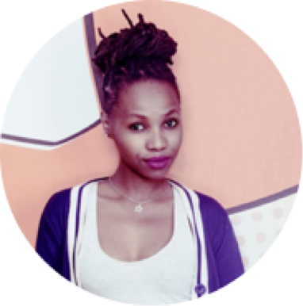
NOMCEBO BUTHELEZI
Social Media Portfolio

Slide 2
In the beginning there was Eskom, 49M, Operation Khanyisa & the Lilizela Awards

Slide 3

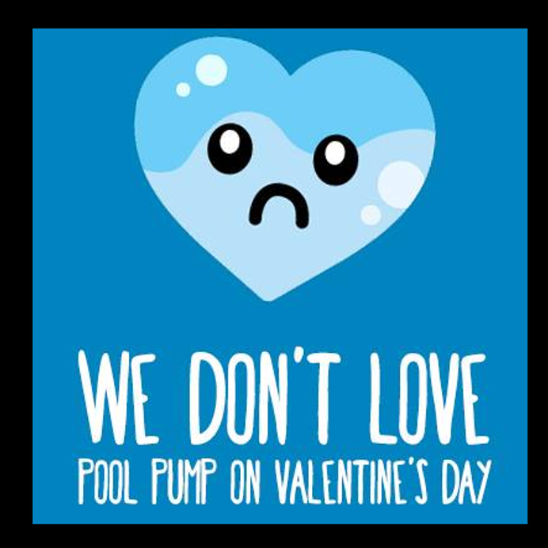
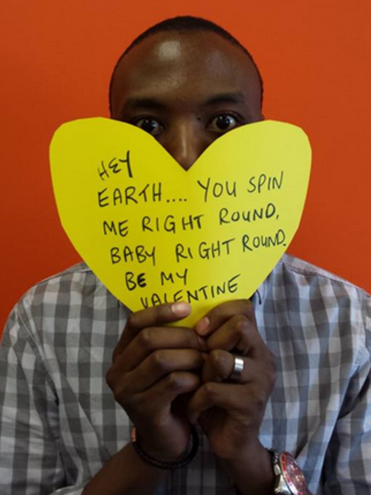
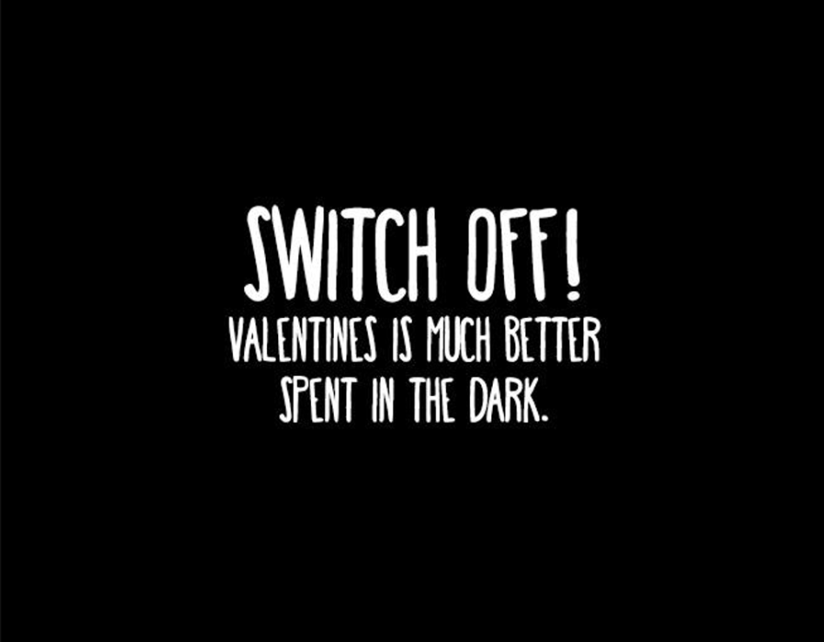
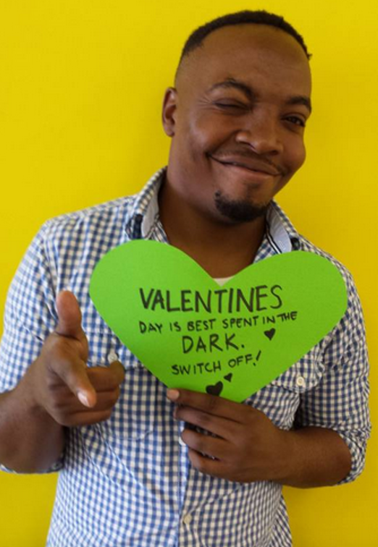
49M Valentine’s Day Campaign

Slide 4
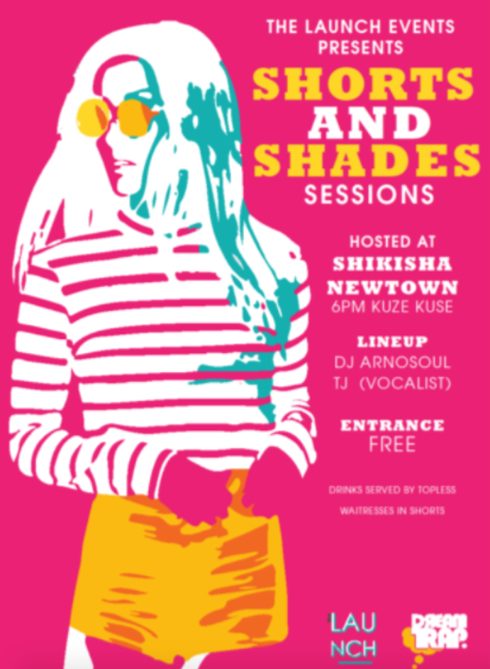
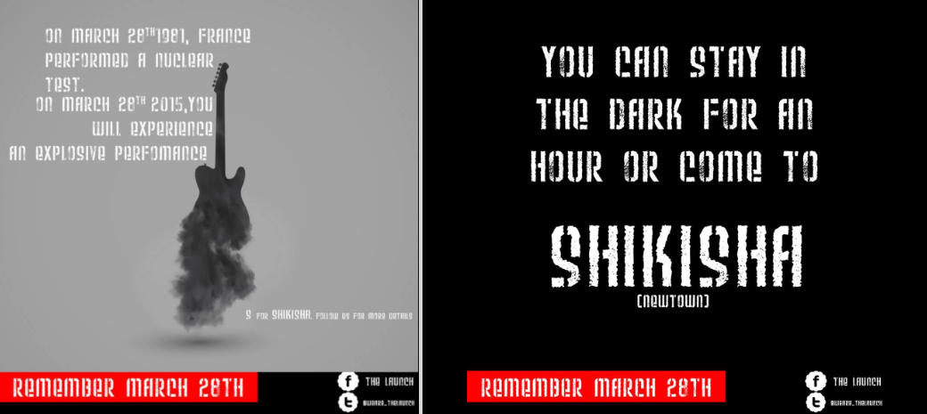
Personal Side Projects
Started an artist promotion company with my mates called “The Launch” between 2014 - 2016. Hosted 2 successful events which we did the graphics and marketing for ourselves.

Slide 5
Fast Forward 3 years later… GAME STORES

Slide 6
Community Management Portfolio
GAME SA FB, TWITTER & INSTAGRAM
GAME AFRICA X10 FACEBOOK PAGES:
Zambia, Ghana, Tanzania, Nigeria, Kenya, Mozambique, Botswana, Uganda, Malawi, Namibia
600 000 Likes
50 000 Followers
7 880 Followers

Slide 7
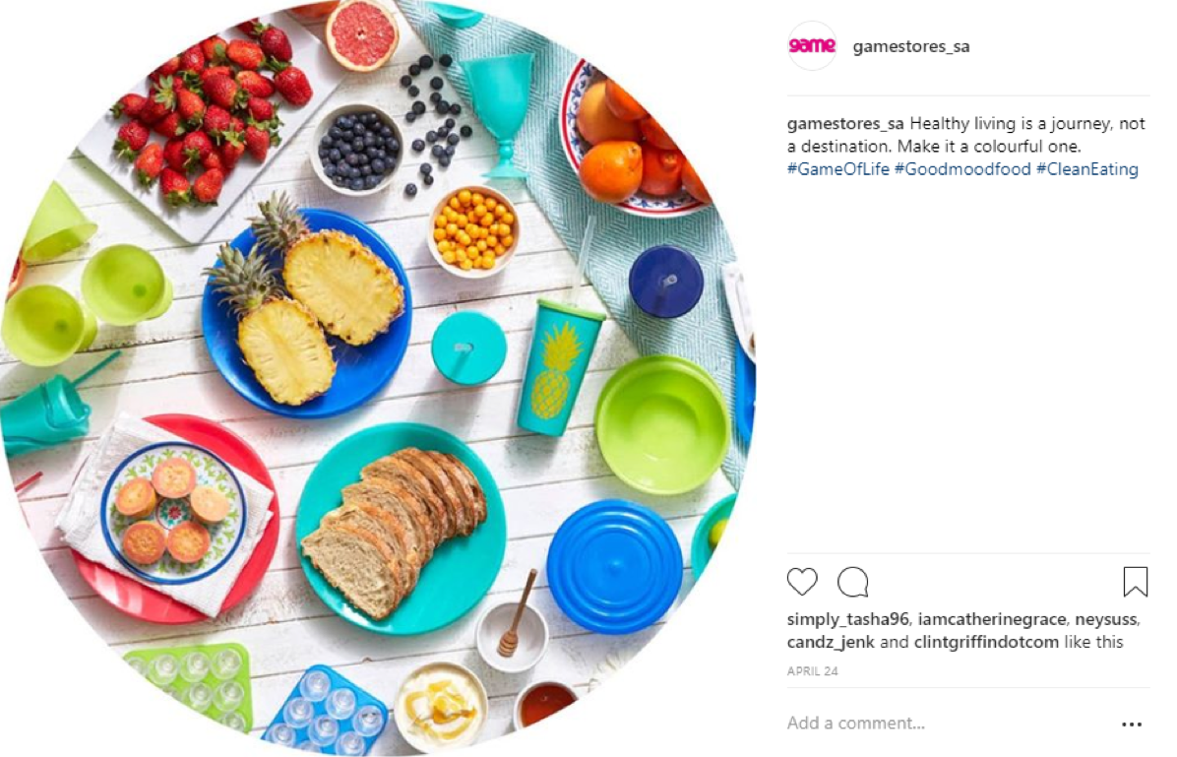
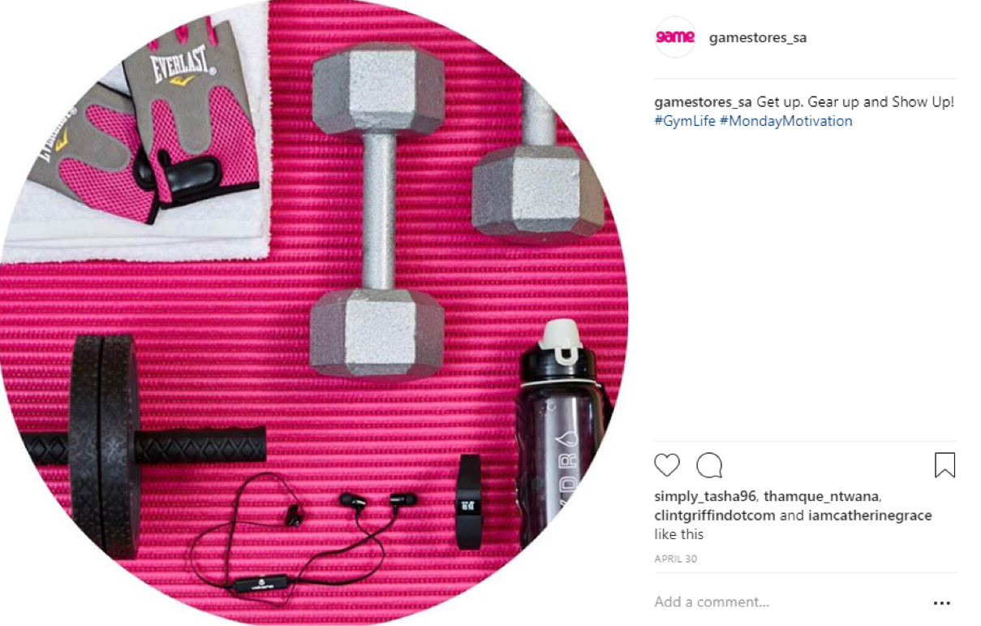
Game Instagram Page Launch
BRIEF SUMMARY
The brand wanted to expand social platforms by getting onto Instagram
Strategy & myself were tasked with positioning Game Stores as a lifestyle brand through the use of rich imagery and storytelling
Instagram strategy - Focus on “Outdoor and Healthy living” aspects of product offering
Use circular template & relevant hashtags as a way to make the page stand out & gain traction
Get outdoor/adventure micro influencers to push lifestyle stories & posts

Slide 8
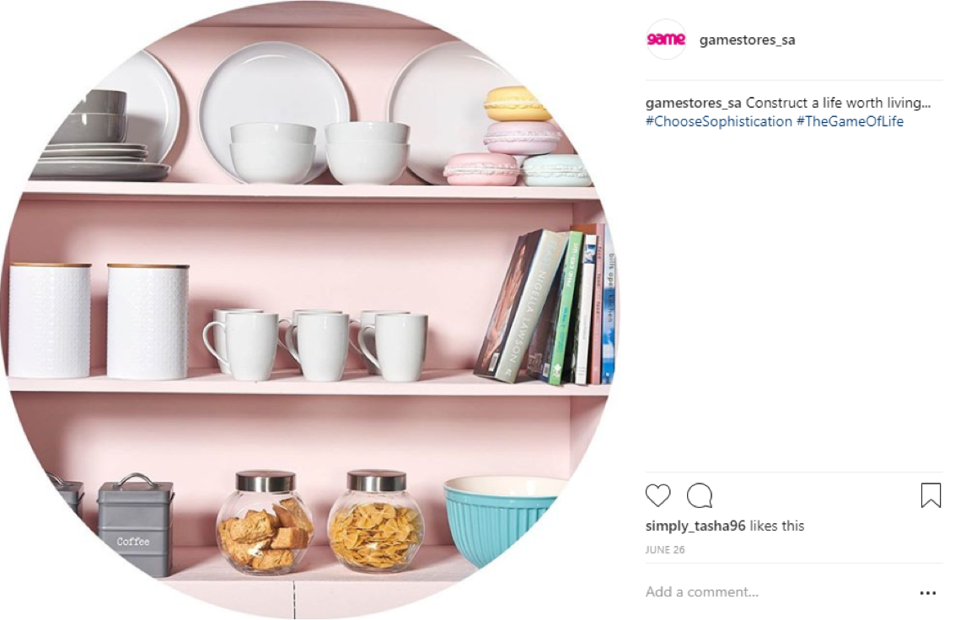
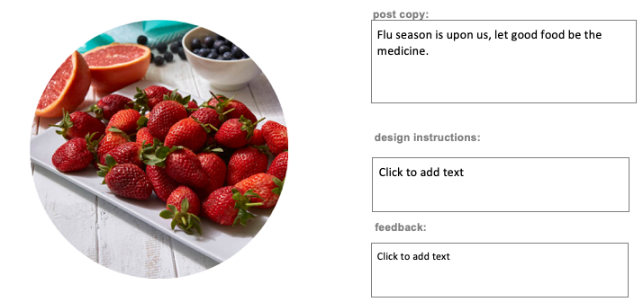
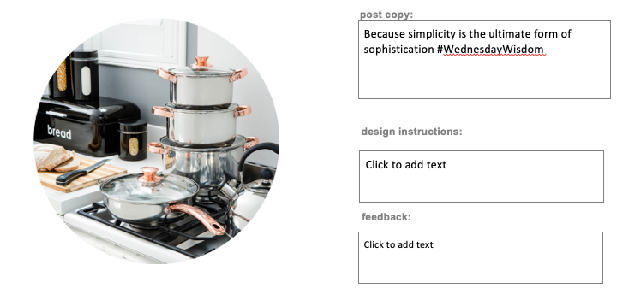
Instagram Page Launch

Slide 9



At Present -
Nestle & Courvoisier

Slide 10
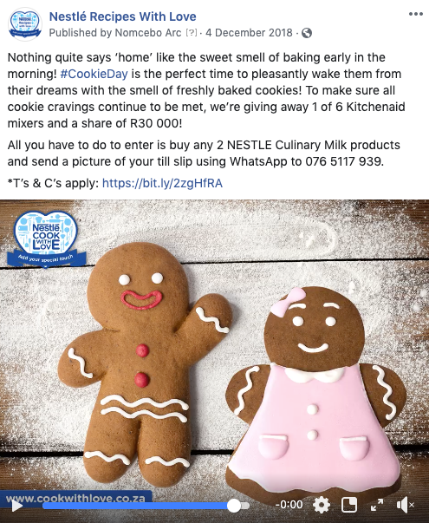

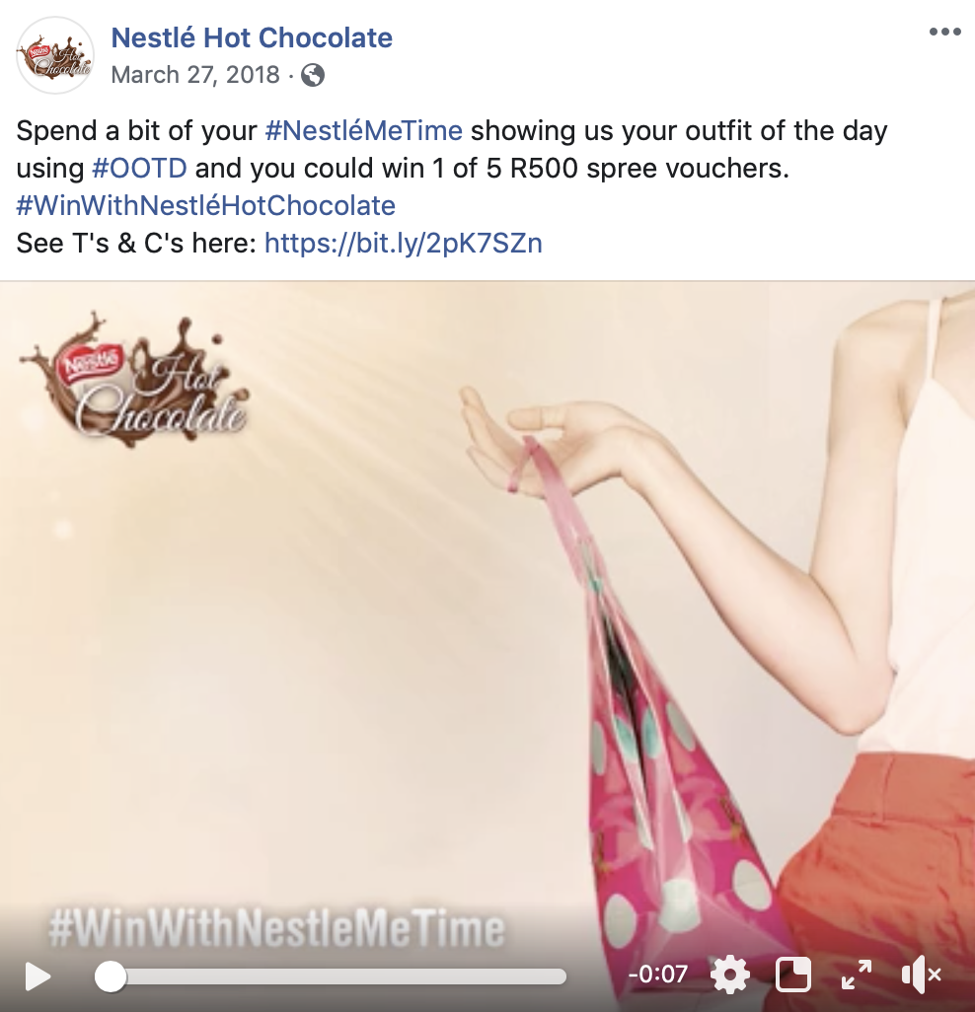
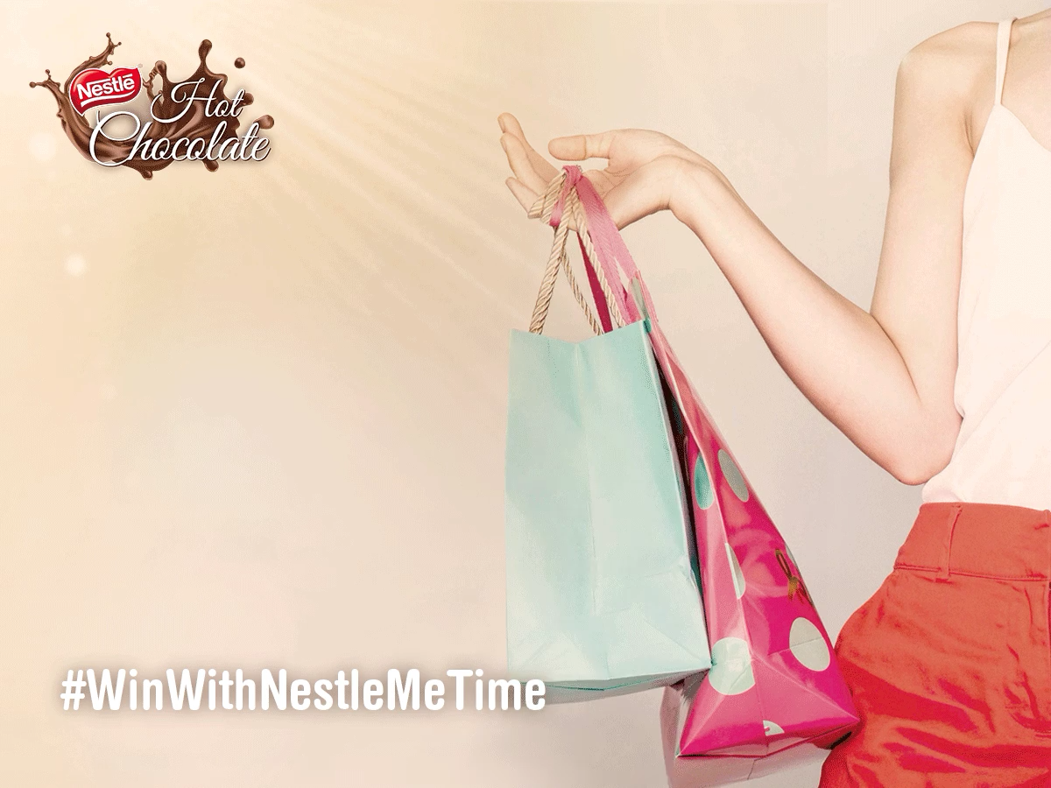
Creative & Copy Examples
Play video
Play video

Slide 11
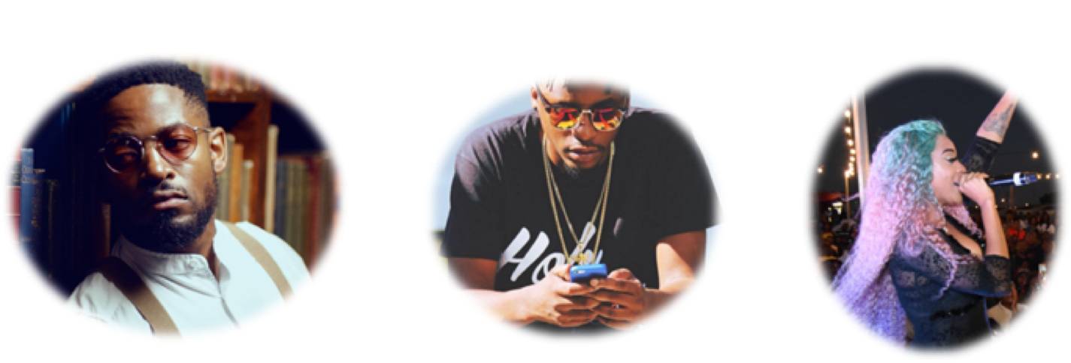
Courvoisier Influencer Campaign
Prince Kaybee
Yanga Chief
Nadia Nakai
BRIEF SUMMARY
Use paid media & social platforms - favouring Instagram to drive reach, engagement & website traffic
Leverage influencer audience to drive awareness & create brand hype, also piggy backing on influencer milestones & events that are relevant to brand comms

Slide 12
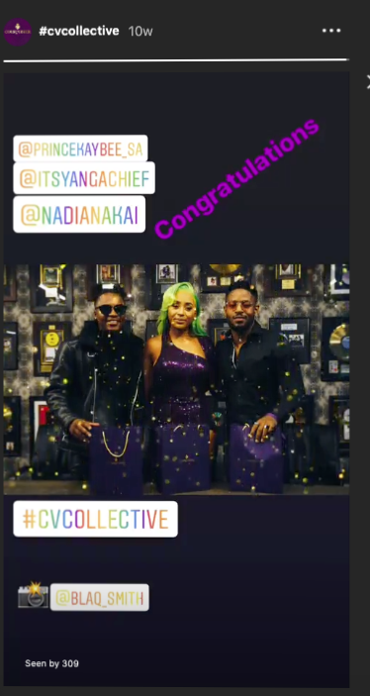
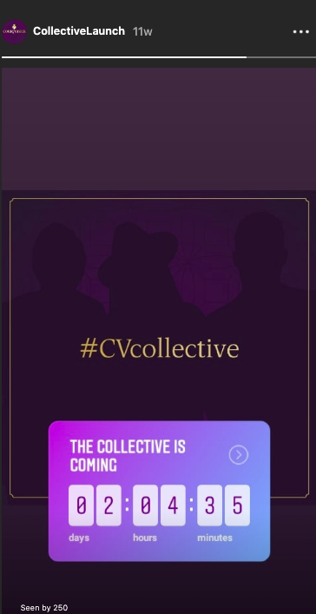
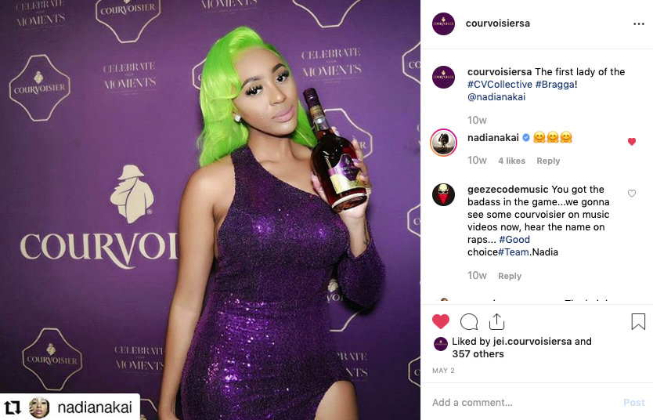
Creative & Copy Examples

Slide 13
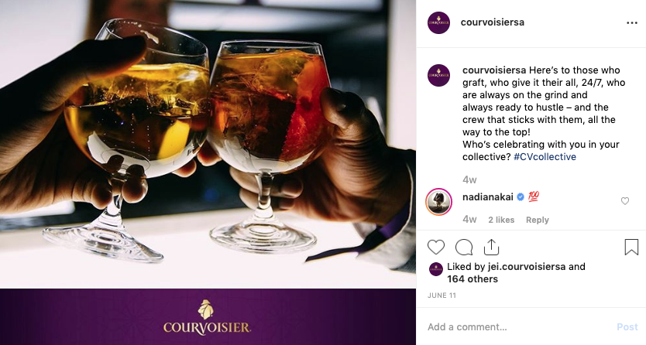
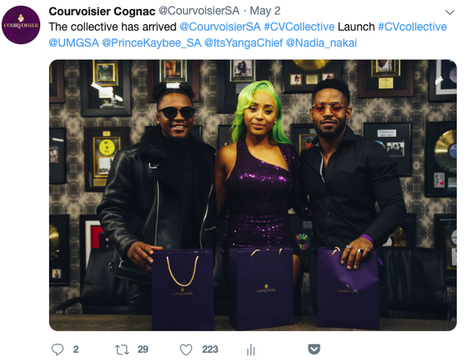
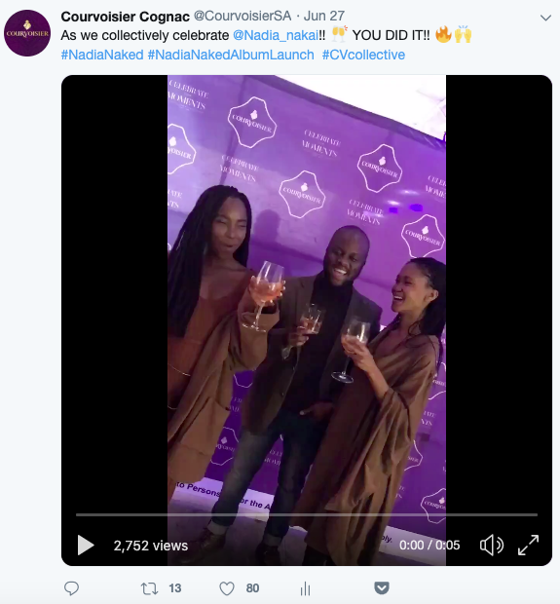
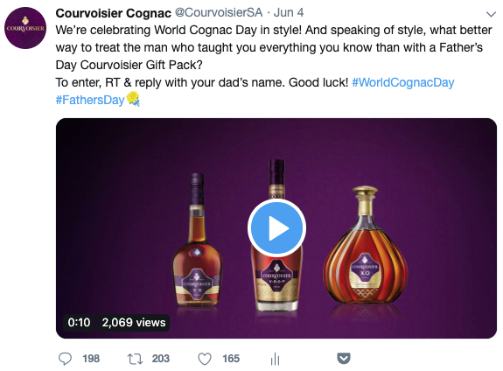
Creative & Copy Examples

Slide 14
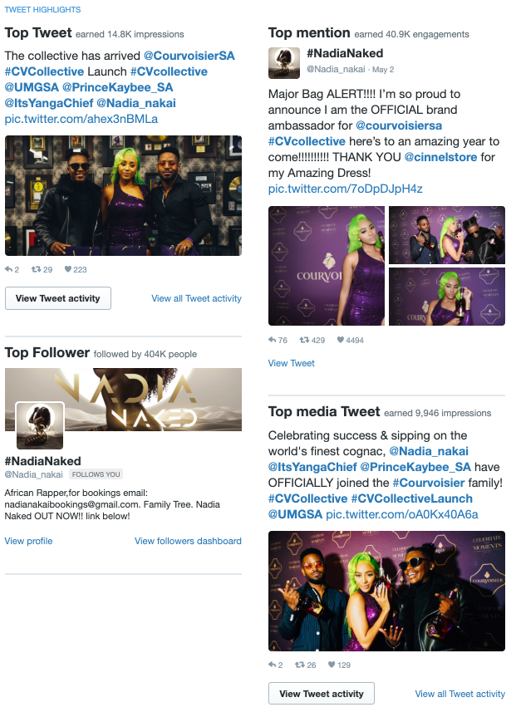
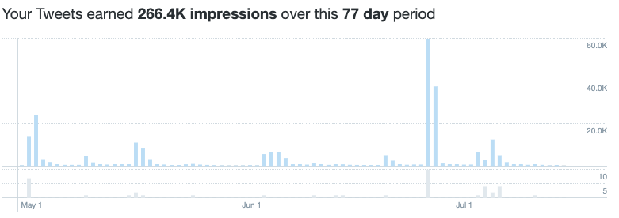
Campaign Results Thus Far
266 400
Impressions
In 2 months
533
New followers
In 2 months
1 700
Likes
In 2 months
40 681
Impressions
In 2 months
320
New followers
In 2 months

Slide 15
THANK YOU

